Slide 1
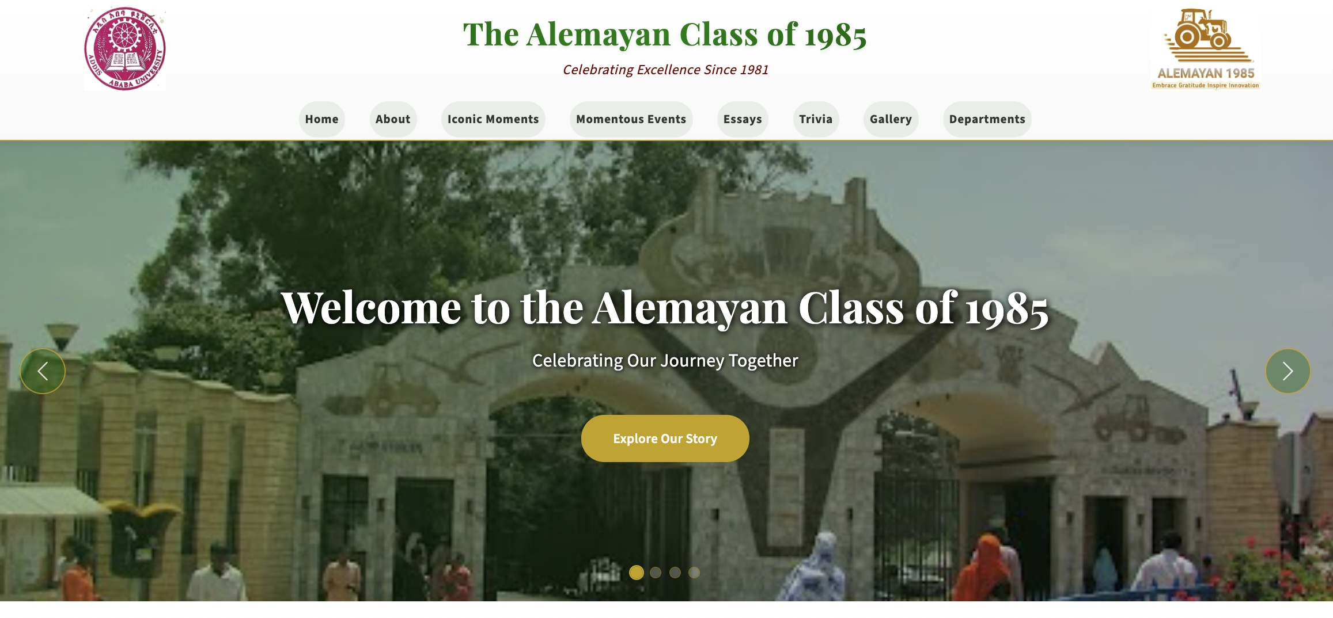
https//Alemayan85.org
Notes:
Planning office told us that we were assigned to IAR
IAR, assigned non-plant science ones to these centers.
Plant Sci students assigned by drawing/lottery.
ZT was the first, Werer, and “Oh, this is good!”

Slide 2
Contents
History of the Alemaya
Yearbook and other Memorablia
Department – list of students and courses
Photo Gallery – B&W, Reunions, Anniversary
Trivia – Music of the time, Fun facts
Reflections and other Resources and Links

Slide 3
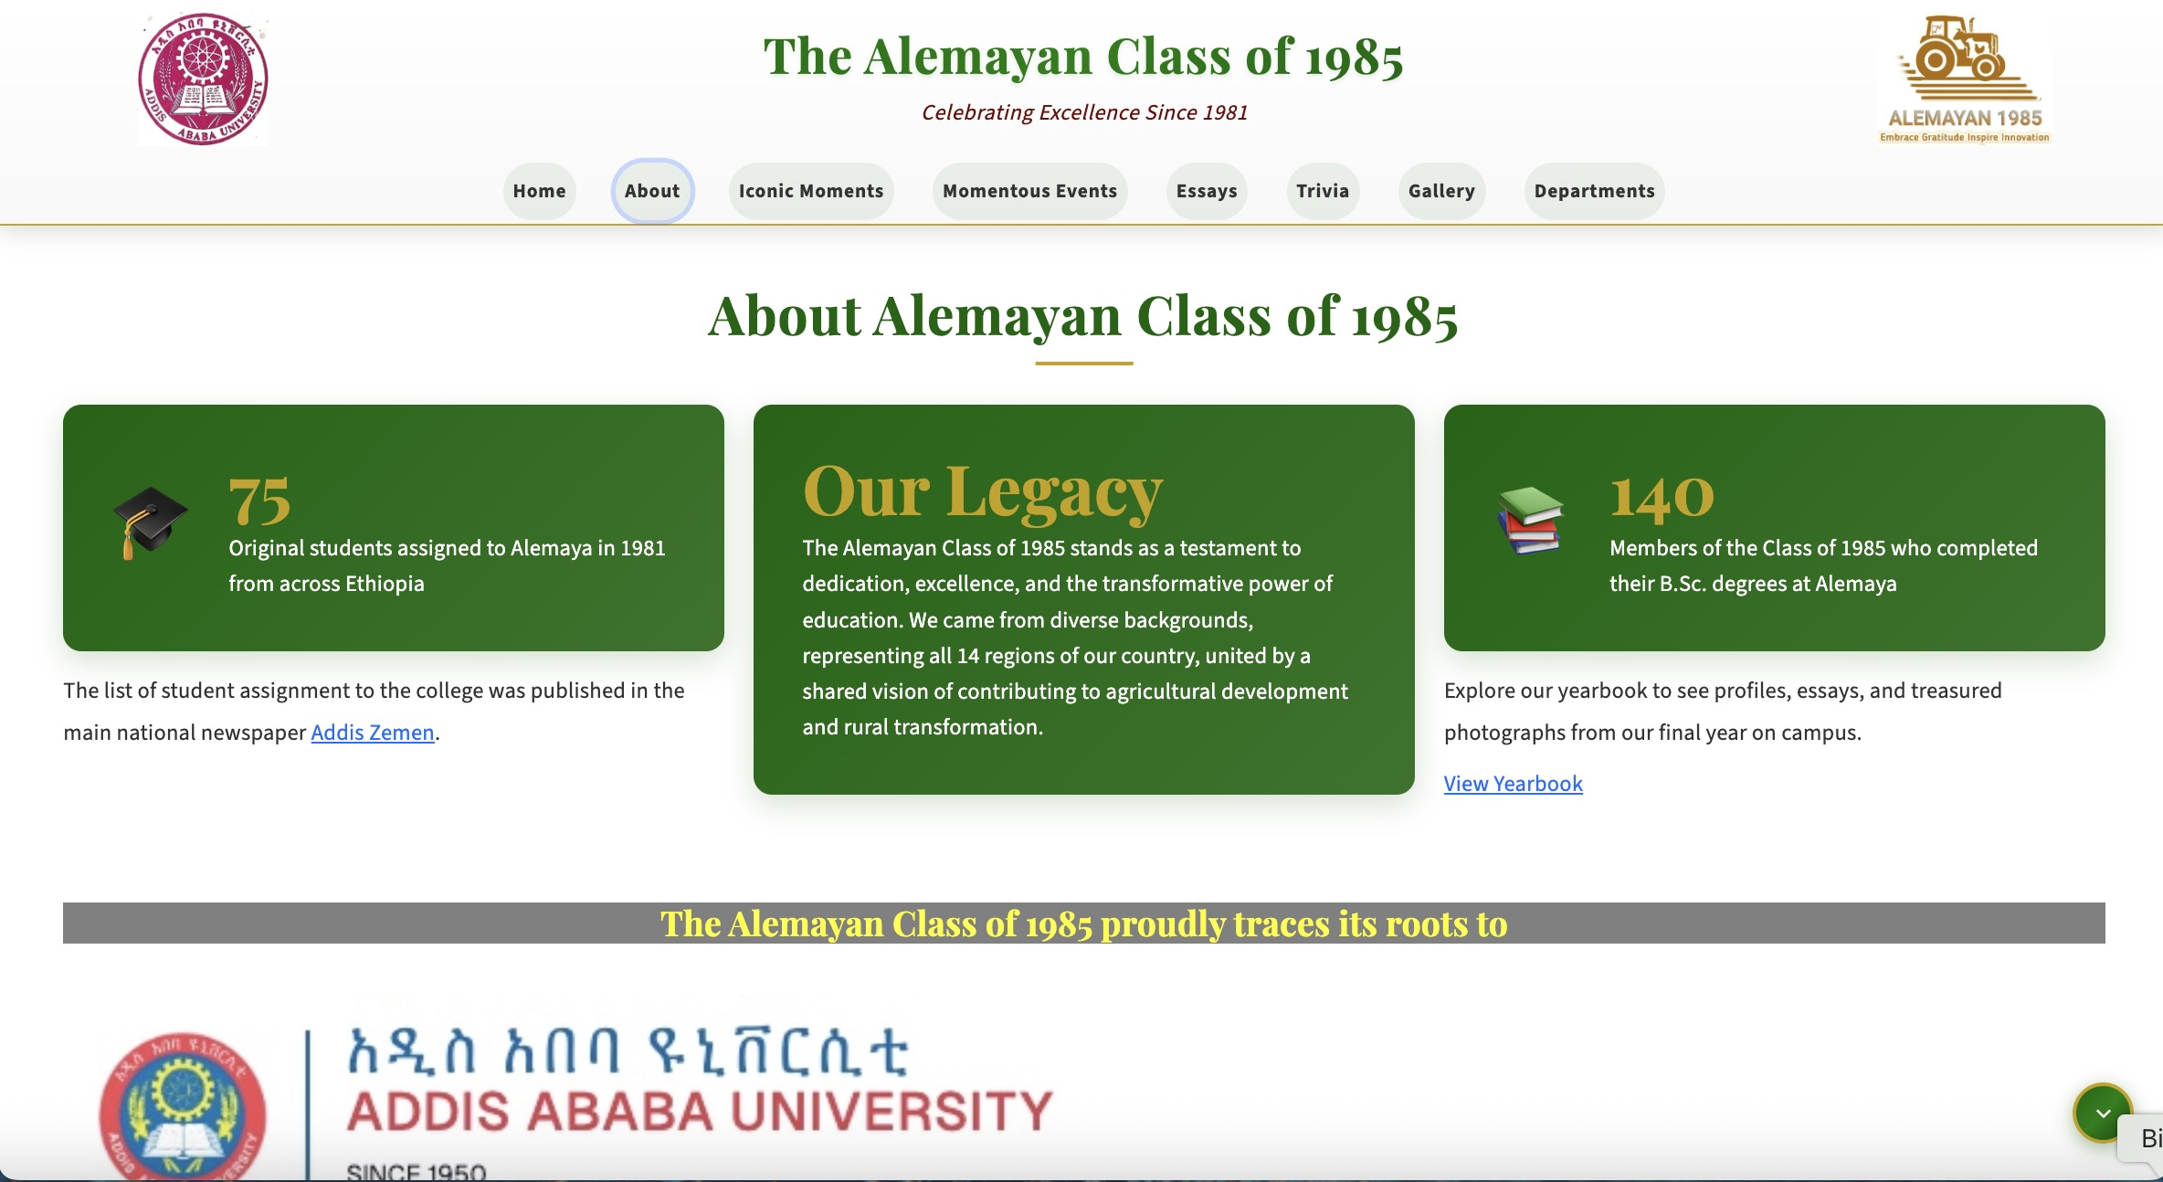
Home Page

Slide 4
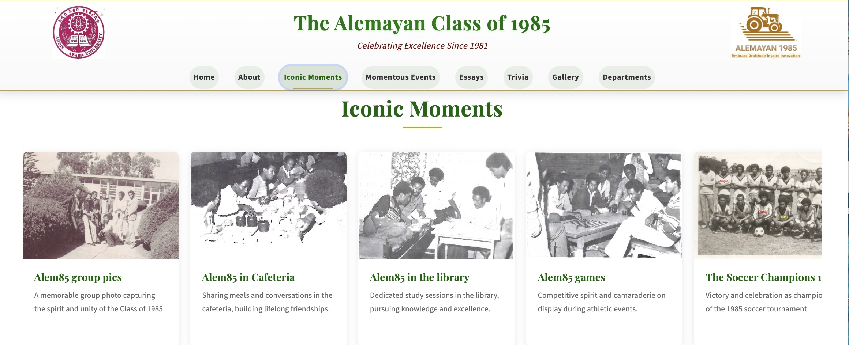
Iconic Moments
Notes:
Politically sensitive
Western countries blamed the government for forcibly resettling people and the ensued disaster
Big officials visit frequently
Projects such as Tana Beles established

Slide 5
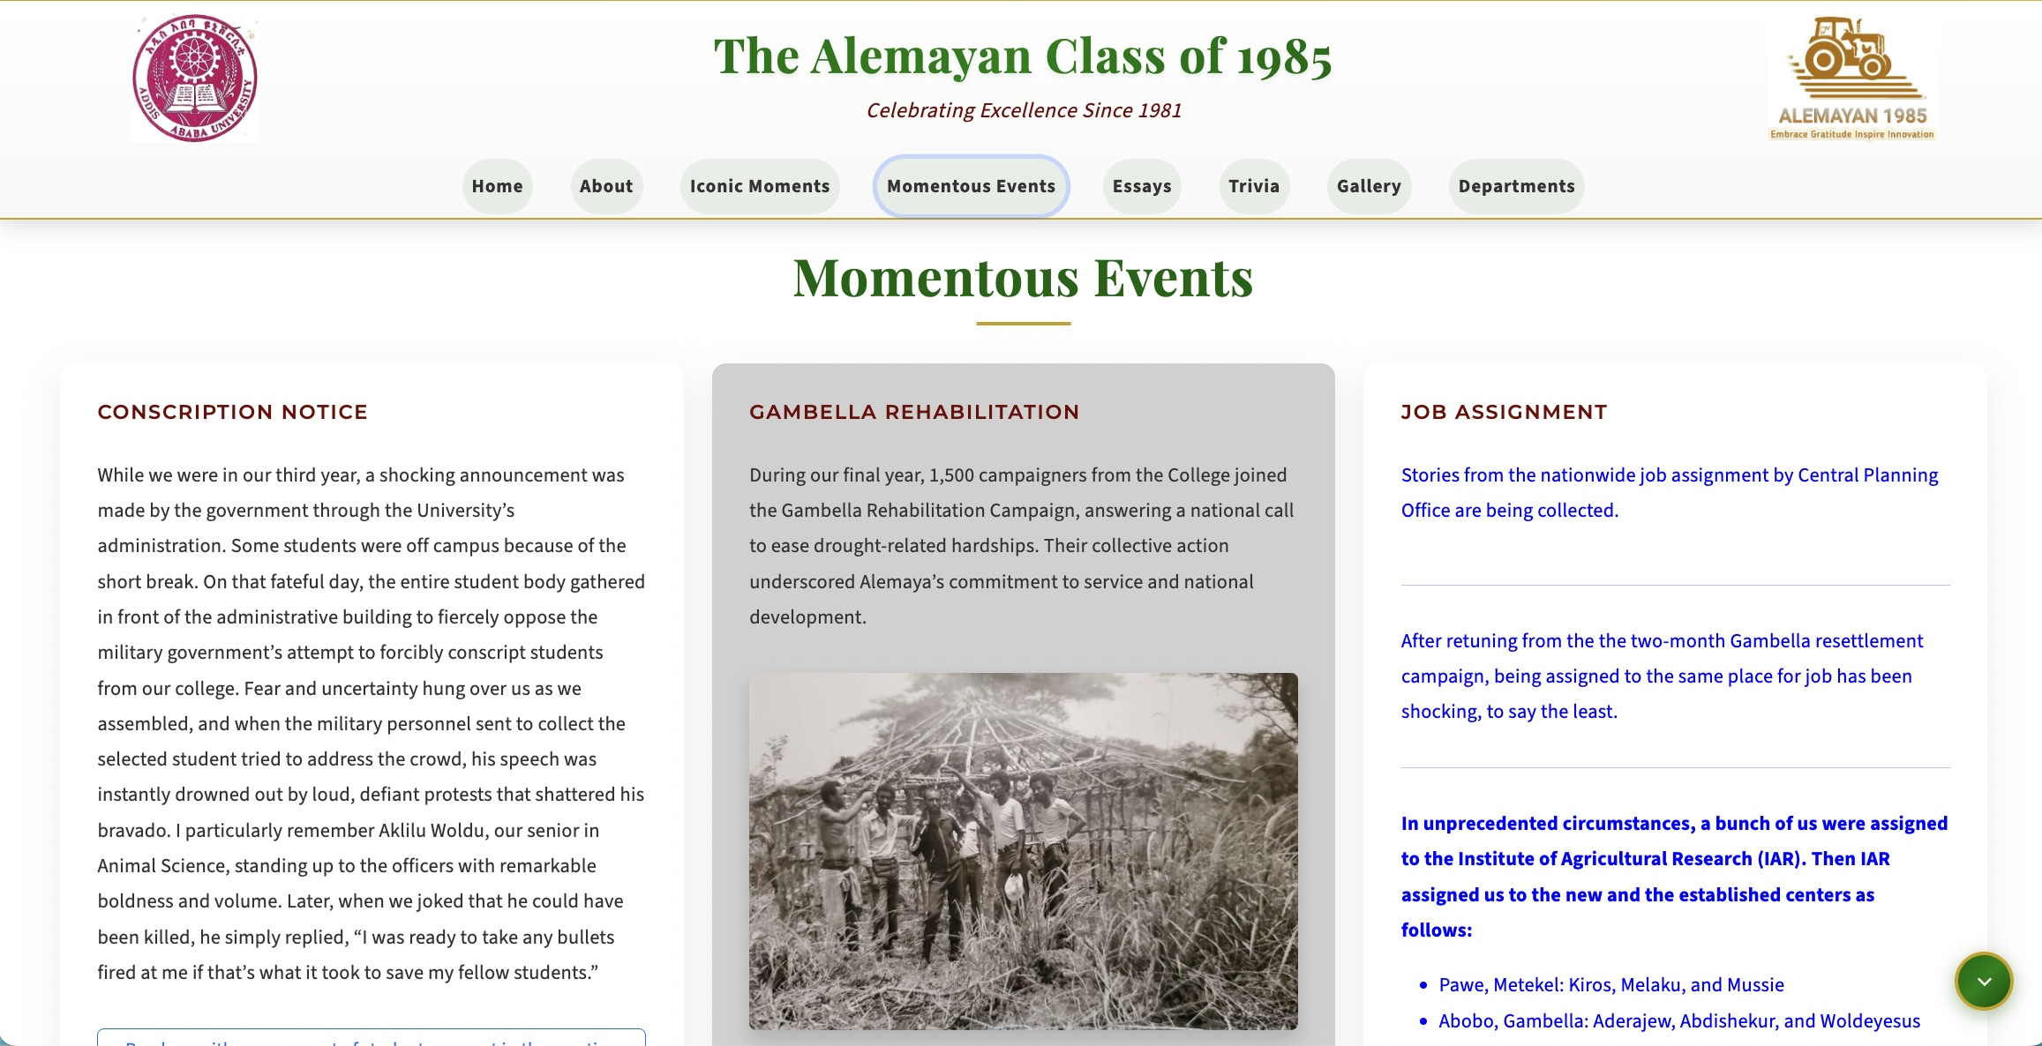
Momentous Events

Slide 6
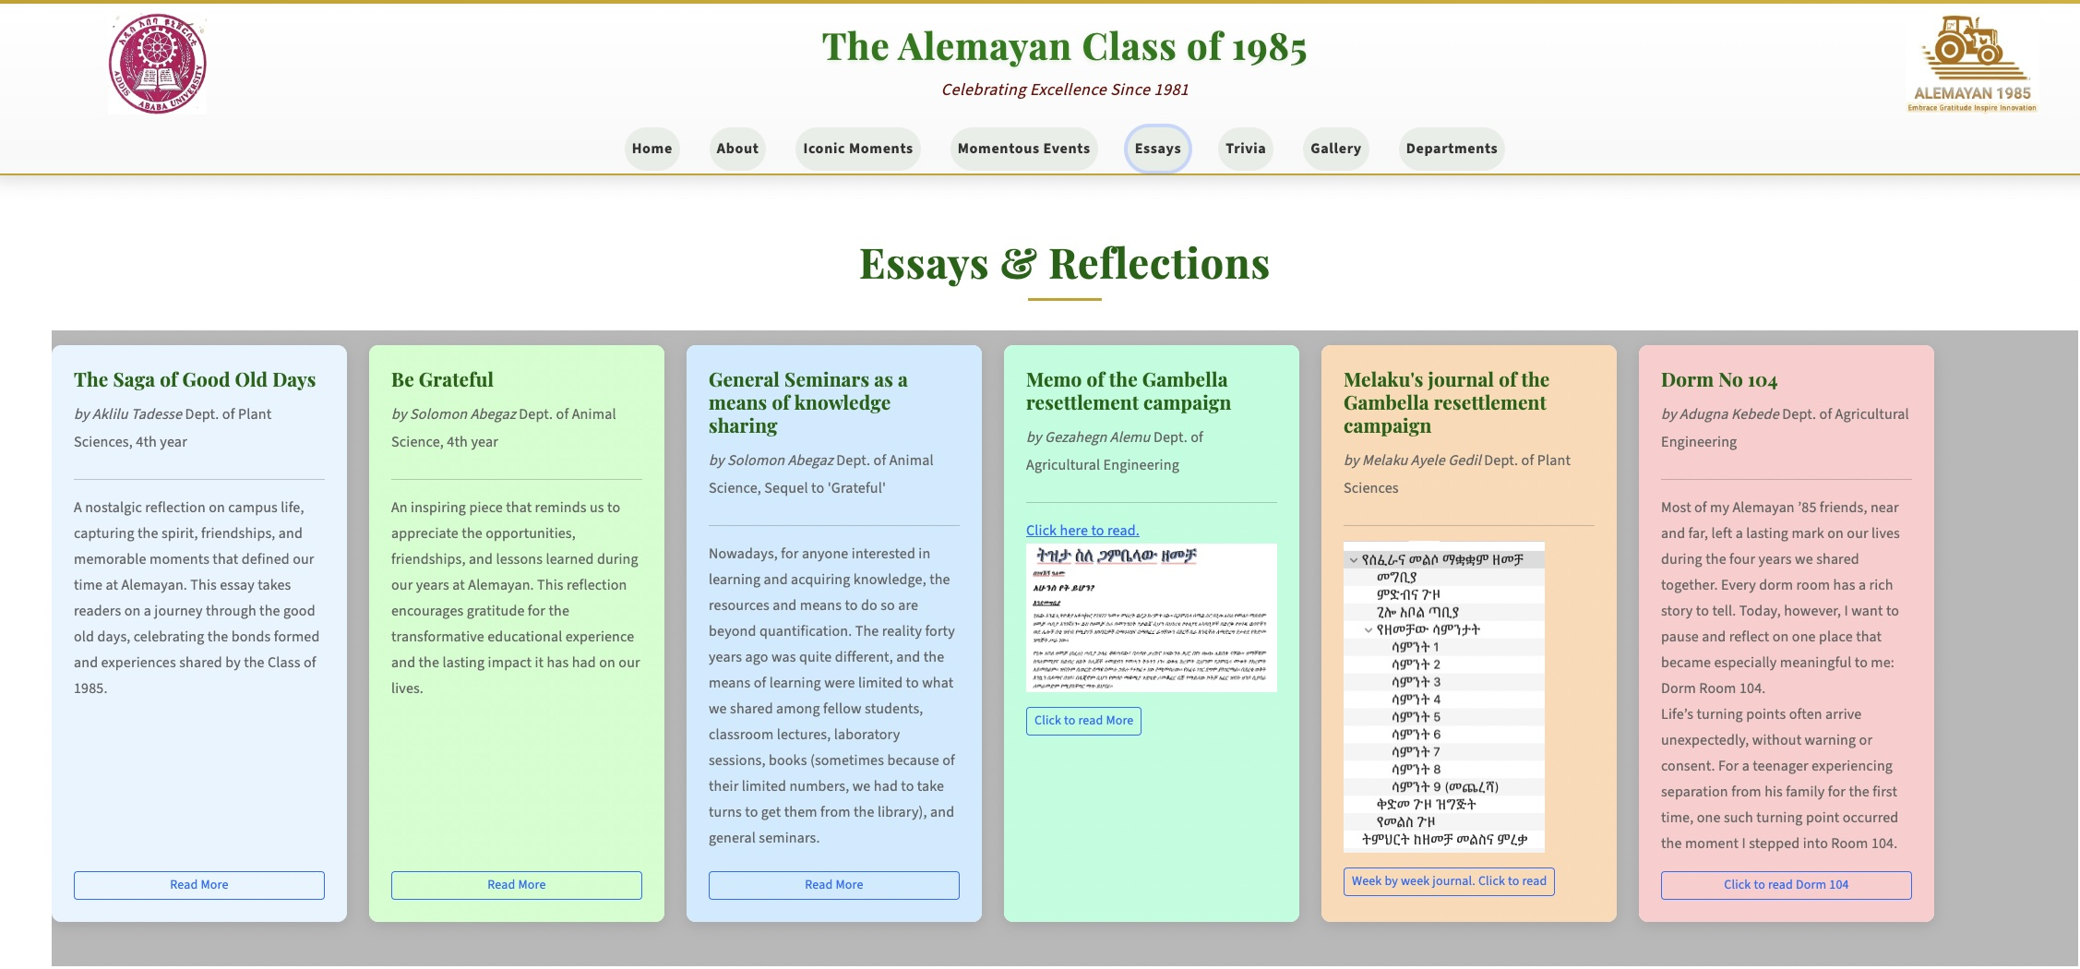
Essays and Reflections

Slide 7
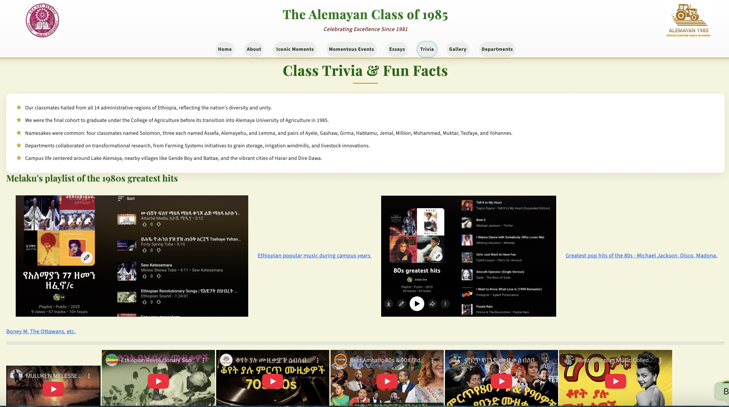
Trivia and Fun Facts
Notes:
In the 1980s, Ethiopia, under the Derg military government, transitioned from former provinces (relabeled regions or kifle hager) to a new system under the 1987 People's Democratic Republic of Ethiopia (PDRE) constitution, creating 30 total divisions: 25 administrative regions and 5 autonomous regions (Eritrea, Tigray, Asseb, Dire Dawa, Ogaden).
Examples of Administrative Regions: North Gondar, South Gondar, North Wollo, South Wollo, Bale, Sidamo, Borana, Arsi, Hararge (East & West), Shoa (North, South, East, West), Gojam (East & West), Wollega, Ilubabor, Kaffa, Gambella, Omo (North & South), Gamo Gofa, Metekel, Addis Ababa, Awi.

Slide 8
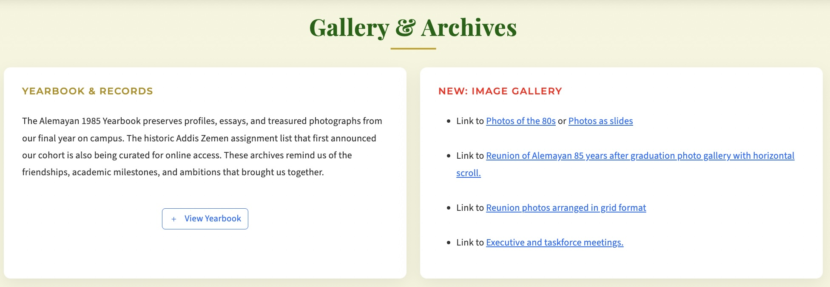
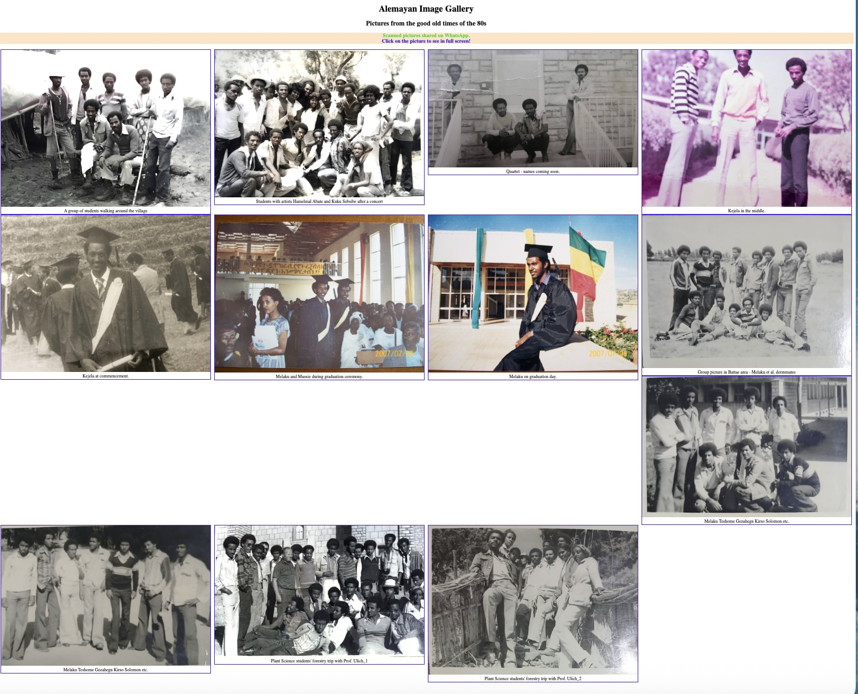
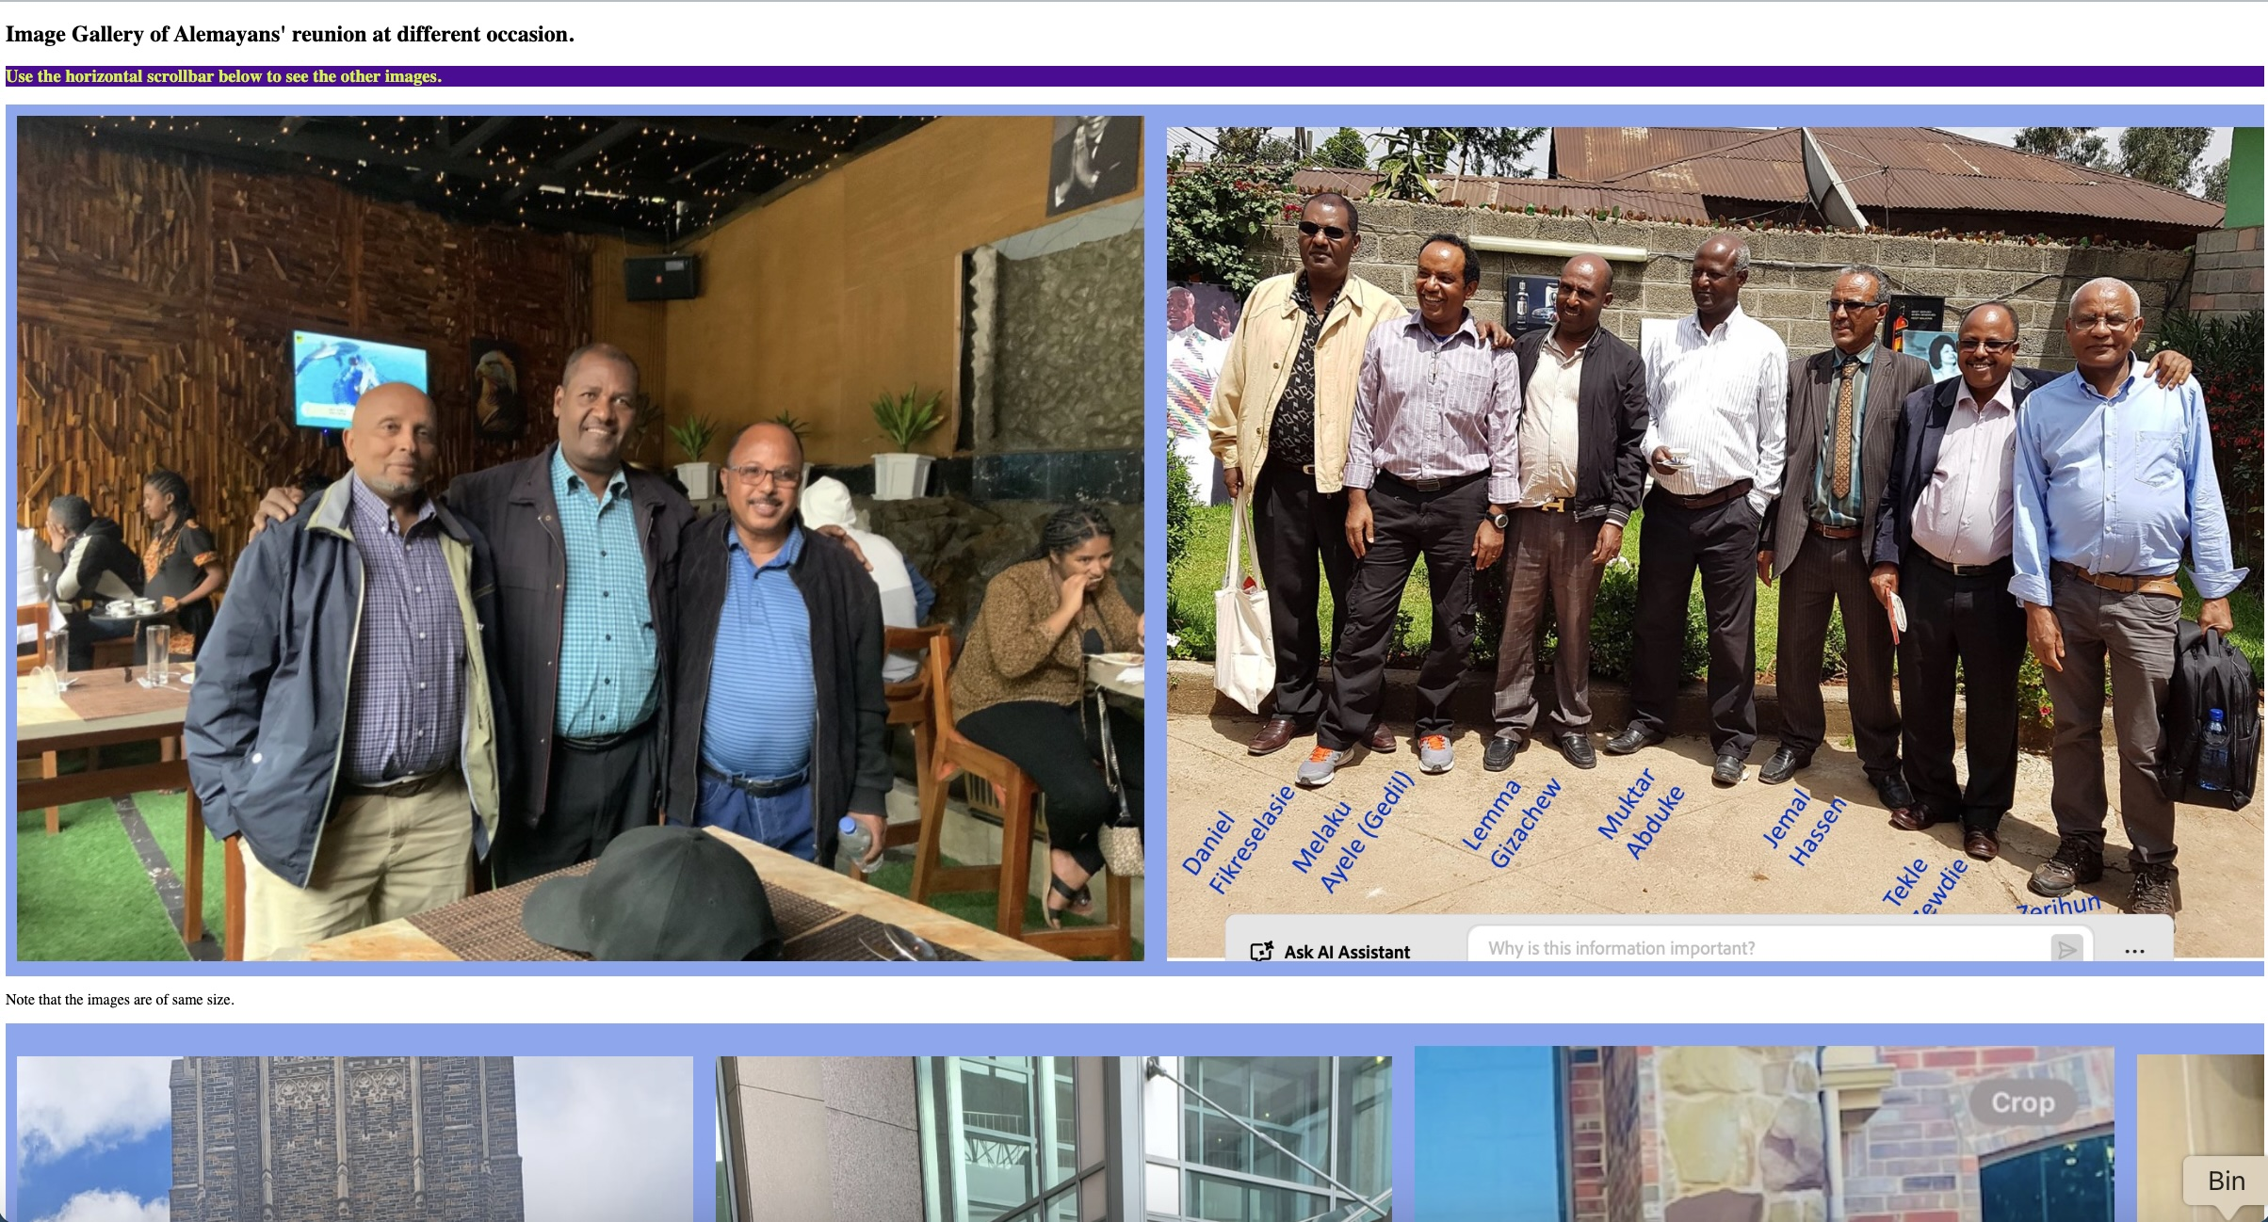
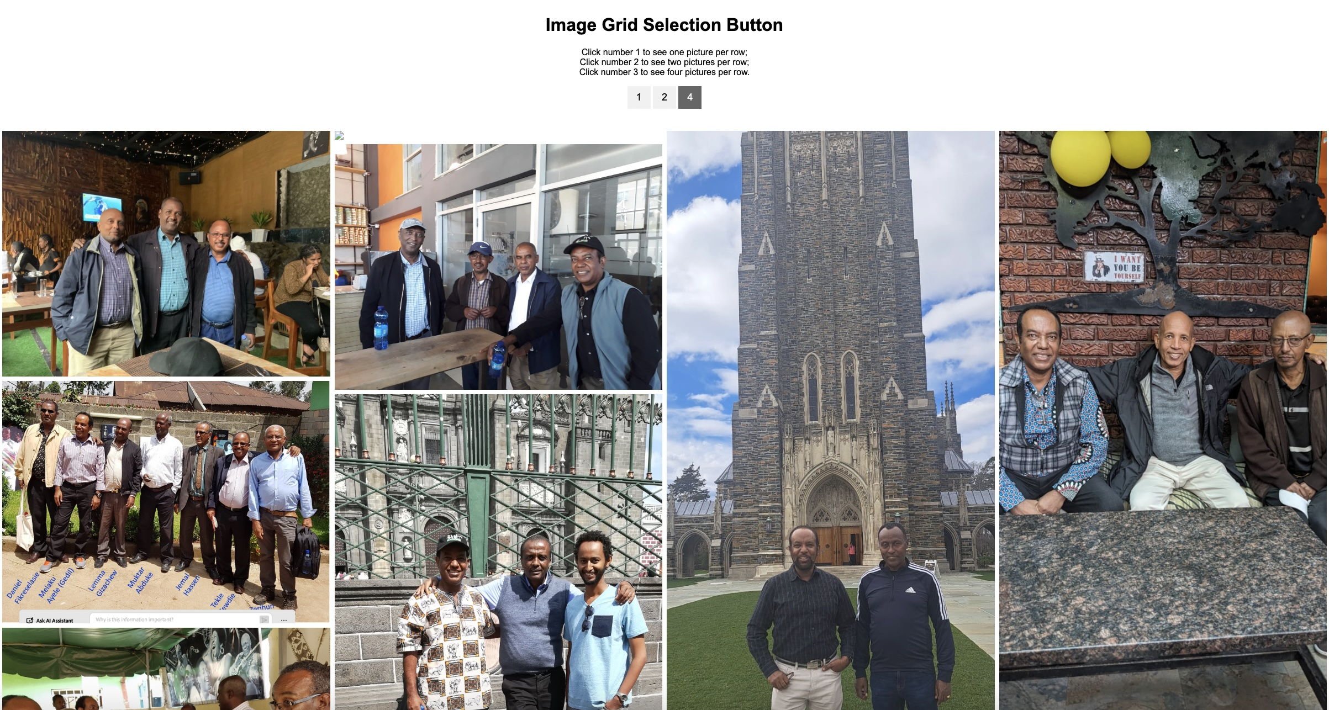

Slide 9
Post Anniversary

Slide 10
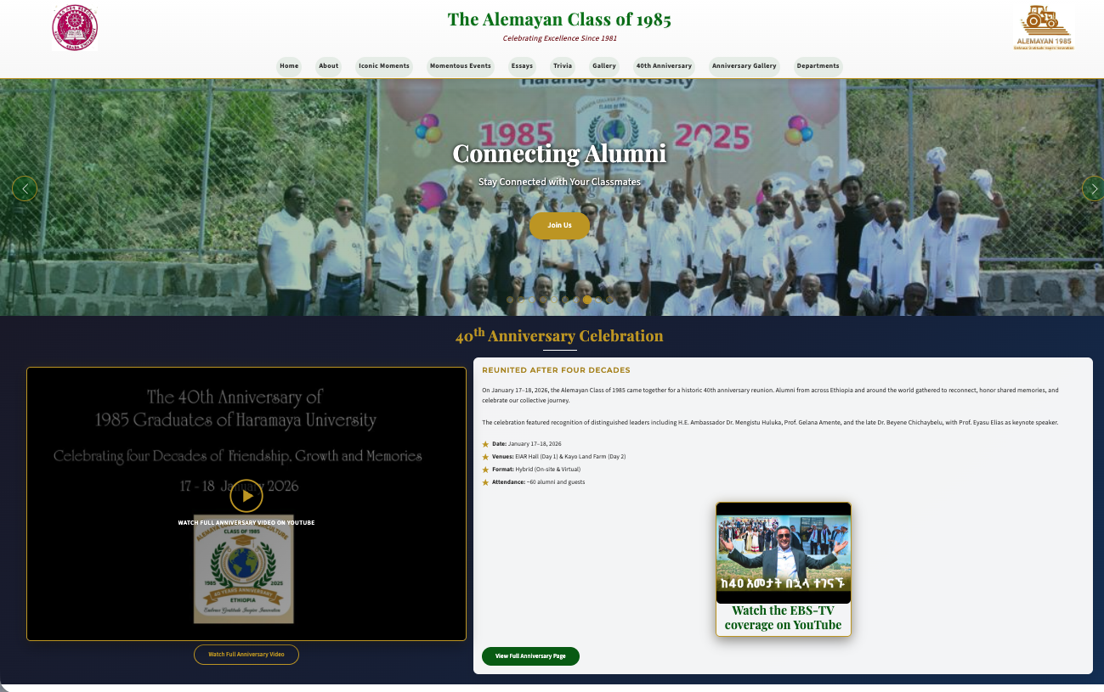

Slide 11
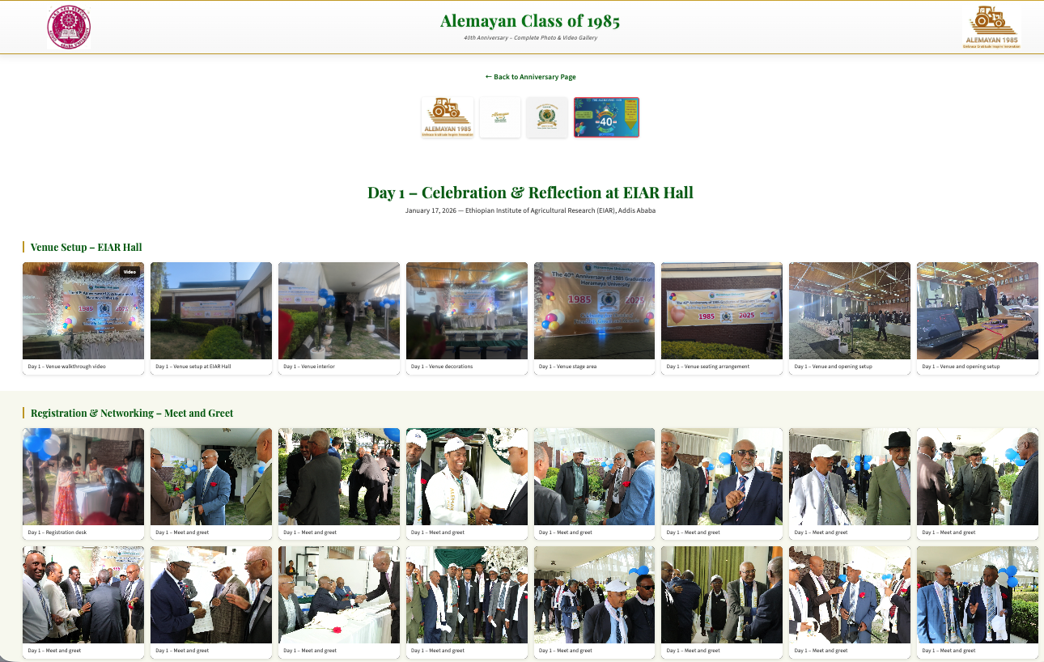

Slide 12
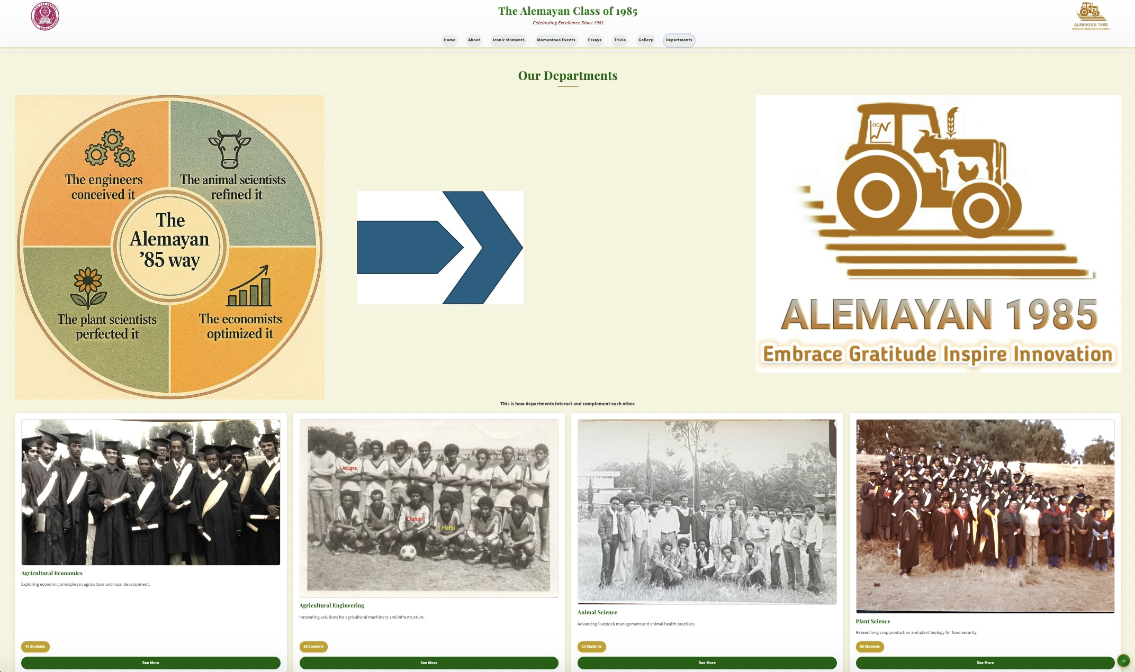
Departments

Slide 13
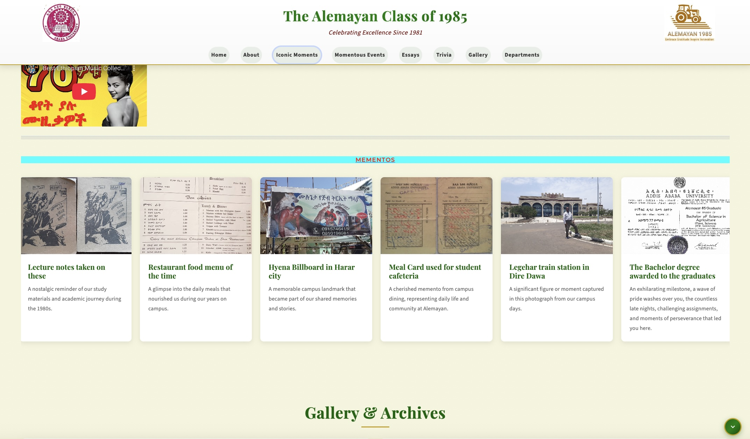
Iconic Moments

Slide 14
Future Plan & Updates
Link to
Addis Ababa University
Haramaya University
EIAR
Alumni Profiles – to be completed

Slide 15

Thank You

